Slide 1
Introduction to pharmacology
By:Ayana J.

Slide 2
General Pharmacology
DEFINITIONS AND SOURCES OF DRUGS
What is
  pharmacology?
  Pharmacokinetics?
  Pharmacodynamics?
  Drug?
  Pharmacotherapeutics
  Clinical pharmacology
  Chemotherapy?
  OTC drugs?
  Prescription drugs?
  Orphan drugs?

Slide 3

Drug Nomenclature
  a drug may be defined as any substance that brings about a change in biologic function through its chemical actions.
  Drugs usually have three types of names.

Slide 4
Nature of Drugs
  In most cases, the drug molecule interacts as an agonist (activator) or antagonist (inhibitor) with a specific target molecule that plays a regulatory role in the biologic system.
The Physical Nature of Drugs
  must have the appropriate size, electrical charge, shape, and atomic composition to interact with its receptors chemically.
  Must travel to its site action
  should be inactivated or excreted from the body at a reasonable rate
  solid, liquid or gaseous at room temperature
  The various classes of organic compounds—carbohydrates, proteins, lipids, and smaller molecules—are all represented in pharmacology.
  oligonucleotides, in the form of small segments of RNA, have entered clinical trials and are on the threshold of introduction into therapeutics.

Slide 5
Drug Size
Drug Reactivity & Drug-Receptor Bonds
  Drugs interact with receptors by means of chemical forces or bonds.
  These are of three major types:
  covalent( (aspirin and cyclooxygenase, DNA-alkylating agents)
  electrostatic(weaker than covalent bonds and
  hydrophobic(highly lipid-soluble drugs with
  the lipids of cell membranes).
  weak bonds require a very precise fit of the drug to its receptor
  if an interaction is to occur (more selective, short acting)

Slide 6
Drug Shape
  chirality (stereoisomerism) so common in biology that more than half of all useful drugs are chiral molecules; that is, they can exist as enantiomeric pairs.
  one of these enantiomers is much more potent than its mirror image enantiomer, reflecting a better fit to the receptor molecule.
  a “left-oriented” drug is more effective in binding to a left-hand receptor than its “right-oriented” enantiomer.

Slide 7
  The more active enantiomer at one type of receptor site may not be more active at another receptor type, eg, a type that may be responsible for some other effect.
    carvedilol, a drug that interacts with adrenoceptors, has a single chiral center and thus two enantiomers
  The (S)(–) isomer, is a potent β-receptor blocker.
  The (R)(+) isomer is 100-fold weaker at the β receptor.

Slide 8
  However, the isomers are approximately equipotent as α-receptor blockers.
Ketamine is an intravenous anesthetic.
  The (+) enantiomer is a more potent anesthetic and is less toxic than the (–) enantiomer.
  However, the isomers are approximately equipotent as α-receptor blockers.
  Unfortunately, the drug is still used as the racemic mixture.
enzymes are usually stereoselective, one drug
enantiomer is often more susceptible than the other to drugmetabolizing enzymes.
  the duration of action of one enantiomer may be quite different from that of the other.
Similarly, drug transporters may be stereoselective.

Slide 9
Unfortunately, most studies of clinical efficacy and drug elimination in humans have been carried out with racemic mixtures of drugs
rather than with the separate enantiomers.
At present, only a small percentage of the chiral drugs used clinically are marketed as the active isomer—the rest are available only as racemic mixtures.
As a result, most patients receive drug doses of which 50% is less active or inactive.
Some drugs are currently available in both the racemic and the pure, active isomer forms.
However, proof that administration of the pure, active enantiomer decreases adverse effects relative to those produced by racemic formulations has not been established.

Slide 10
Rational Drug Design
  implies the ability to predict the appropriate molecular structure of a drug on the basis of information about its biologic receptor.
  Until recently, no receptor was known in sufficient detail to permit such drug design.
    Drugs were developed through random testing of chemicals or modification of drugs already known to have some effect.
  A few drugs now in use were developed through molecular design based on knowledge of the threedimensional structure of the receptor site.
  Computer programs are now available that can iteratively optimize drug structures to fit known receptors.
  As more becomes known about receptor structure, rational drug design will become more common.

Slide 11
A number of useful or dangerous drugs are inorganic elements,
eg, lithium, iron, and heavy metals
many organic drugs are weak acids or bases
  pH differences in the various compartments of the body may alter the degree of ionization
  of weak acids and bases

Slide 12
Sources of Drugs
The sources of drugs can be
Natural:-
  plants(morphine, atropine, quinine, reserpine, ephedrine, digoxin ),
  animals(Insulin, heparin),
  minerals(Ferrous sulphate, magnesium sulphate),
  microorganisms(Penicillin, streptomycin, griseofulvin), etc.
Semisynthetic:- obtained from natural sources and are chemically modified later.
  Hydromorphone, hydrocodone
Notes:
Drugs are also produced by genetic engineering (DNA recombinant technology), e.g. human insulin,
human growth hormone, hepatitis B vaccine

Slide 13
Synthetic:- produced artificially.
  Most of the drugs used today are synthetic(aspirin, paracetamol etc).
  recombinant DNA technology permitted synthesis of proteins by various organisms (bacteria, yeast) and mammalian cells.
  The usual approach to invention of a small-molecule drug is to screen a collection of chemicals (“library”) for compounds with the desired features.
  An alternative is to synthesize and focus on close chemical relatives of a substance known to participate in a biological reaction of interest (e.g., congeners of a specific enzyme substrate chosen to be possible inhibitors of the enzymatic reaction), a particularly important strategy in the discovery of anticancer drugs.

Slide 14
Drug discovery in the past often resulted from serendipitous observations of the effects of plant extracts or individual chemicals on animals or humans;
today’s approach relies more on high-throughput screening of libraries containing hundreds of thousands or even millions of compounds for their capacity to interact with a specific molecular target or elicit a specific biological response.

Slide 15
ROUTES OF DRUG ADMINISTRATION
Drug- and patient-related factors determine the selection of routes for drug administration. The factors are:
  Characteristics of the drug.
  Emergency/routine use.
  Site of action of the drug—local or systemic.
  Condition of the patient (unconscious, vomiting, diarrhoea).
  Age of the patient.
  Effect of gastric pH, digestive enzymes and first-pass metabolism.
  Patient’s/doctor’s choice (sometimes)

Slide 16
Discuss the advantages of each route of administration?

Slide 17
Pharmacokinetics
(Absorption, Distribution, Metabolism and Excretion of Drugs)
Pharmacokinetics is the quantitative study of
drug movement in, through and out of the body.
Intensity of response is related to concentration of the drug at the site of action, which in turn is dependent on its PK properties.
determines the route(s) of administration, dose, latency of onset, time of peak action, duration of action and thus frequency of administration of a drug.
involve transport of the drug across biological membranes

Slide 18
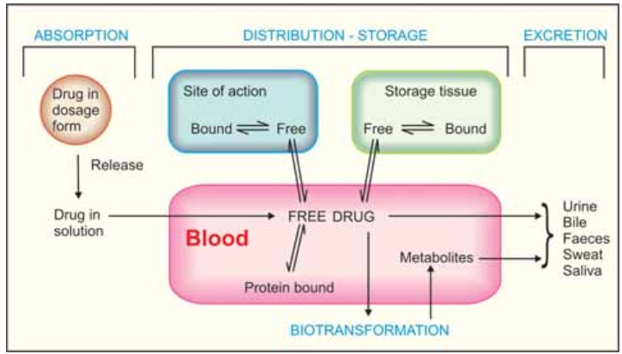

Slide 19
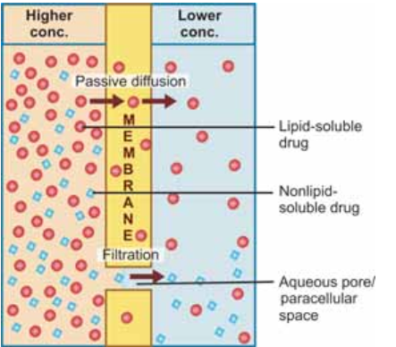
Drugs are transported across the membranes by:
(a) Passive diffusion and filtration.
(b) Specialized transport.

Slide 20
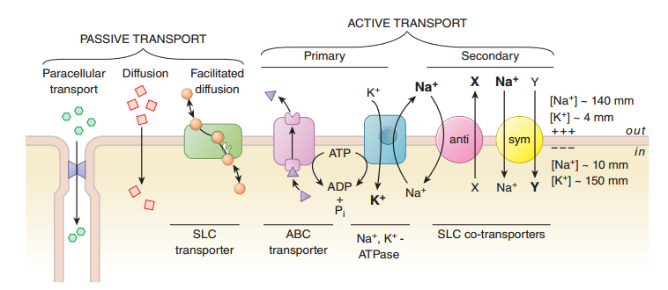
Drugs move across membrane and cellular barriers in a variety of ways

Slide 21
Passive diffusion
The drug diffuses across the membrane in the direction of its concentration gradient, the membrane playing no active role in the process.
This is the most important mechanism for majority of drugs; drugs are foreign substances and specialized mechanisms are developed by the body for normal metabolites only.
Affected by
  Nature of drug(lipid solubility, lipid: water partition coefficient)
  Concentration of drugs
  PH of the membrane

Slide 22

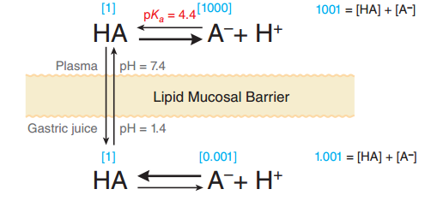



Influence of pH difference on two sides of a biological membrane on the distribution of a weakly acidic drug with pKa = 6
At steady state, an acidic drug will accumulate on the more basic side
of the membrane and a basic drug on the more acidic side.
Lipid-soluble nonelectrolytes (e.g. ethanol, diethyl-ether) readily cross biological membranes and their transport is pH independent.

Slide 23
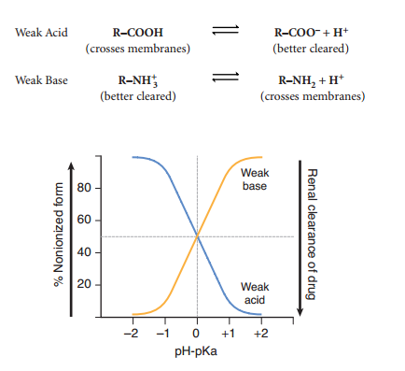
Degree of Ionization and Clearance Versus pH Deviation from pKa

Slide 24
Implications of this consideration are:
Acidic drugs, e.g. aspirin (pKa 3.5) are largely unionized at acid gastric pH and are absorbed from stomach, while bases, e.g. atropine (pKa 10) are largely ionized and are absorbed only when they reach the intestines.
The unionized form of acidic drugs which crosses the surface membrane of gastric mucosal cell, reverts to the ionized form within the cell (pH 7.0)
  ion trapping???
Basic drugs attain higher concentration intracellularly (pH 7.0 vs 7.4 of plasma).
Acidic drugs are ionized more in alkaline urine—do not back diffuse in the kidney tubules and are excreted faster. Accordingly, basic drugs are excreted faster if urine is acidified.

Slide 25
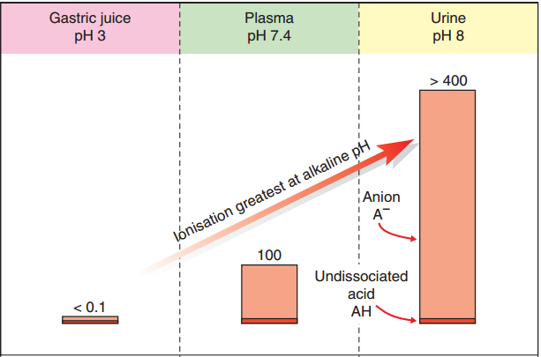
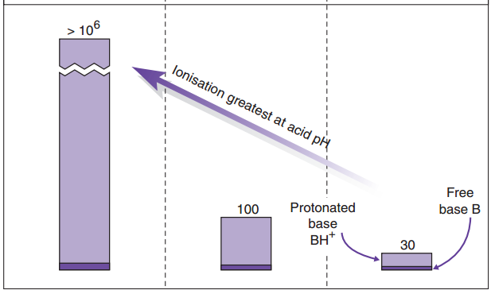
Aspirin (pKa 3.5 )
Relative concentration
Pethidine (pKa 8.6)

Slide 26
There are several important consequences of pH partition:
  Free-base trapping of some antimalarial drugs (e.g.chloroquine )
  Urinary acidification accelerates excretion of weak bases and retards that of weak acids
  Urinary alkalinisation has the opposite effects
  Increasing plasma pH (e.g. by administration of sodium bicarbonate) causes weakly acidic drugs to be extracted from the CNS into the plasma.
  reducing plasma pH (e.g. by administration of a carbonic anhydrase inhibitor such as acetazolamide) causes weakly acidic drugs to become concentrated in the CNS

Slide 27
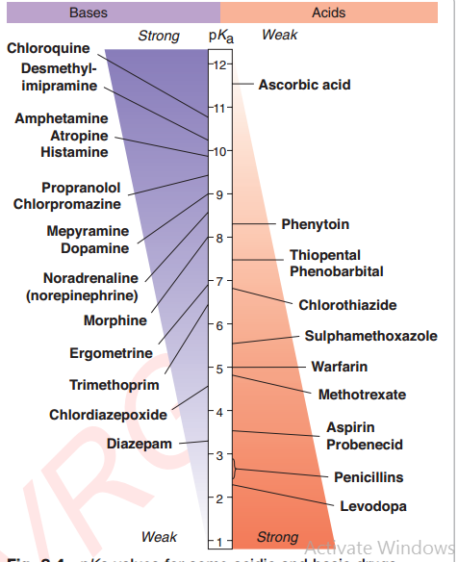
PKa values for some acidic and basic drugs

Slide 28
Filtration
Pressure gradient
Molecular size
Rate of blood flow but not lipid solubility

Slide 29
Specialized transport
This can be carrier mediated or by pinocytosis
Carrier transport
All cell membranes express a host of transmembrane proteins which serve as carriers or transporters for physiologically important
    ions, nutrients, metabolites, transmitters, etc. across the membrane.
    certain transporters also translocate xenobiotics, including drugs and their metabolites.

Slide 30
  Specific for the substrate (or the type of substrate, e.g. an
  organic anion), saturable, competitively inhibited by analogues which utilize the same transporter
  Depending on requirement of energy, carrier transport is of two types:
  1. Facilitated diffusion
    solute carrier (SLC) superfamily.
    No need of energy
    Conc. Gradient(direction dependent)
      e.g. the entry of glucose into muscle and
      fat cells by the glucose transporter GLUT 4
      the Na+–Ca2+exchange protein (SLC8)(antiporter)

Slide 31
2. Active transport
It requires energy
inhibited by metabolic poisons
Transports the solute against its electrochemical gradient resulting in selective accumulation of the substance on one side of the membrane.
Drugs related to normal metabolites can utilize the transport processes meant for these,
  e.g.levodopa and methyl dopa are actively absorbed
  from the gut by the aromatic amino acid transporter.
nonselective transporters, like P-glycoprotein (P-gp)

Slide 32
Active transport can be primary or secondary depending on the source of the driving force
i. Primary active transport Energy is obtained directly by the hydrolysis of ATP
  superfamily of ATP binding cassettee (ABC) transporters whose intracellular loops have ATPase activity.
  P-glycoprotein(BBB, enerocyte) is the most well known primary active
  transporter. AKA multidrug resistance associated protein 2 (MRP 2) and breast cancer resistance protein (BCRP)
    steroid hormones(testosterone and progesterone)
ii. Secondary active transport
  the energy to pump one solute is derived from the downhill movement of another solute (mostly Na+).

Slide 33
OATP and OCT, highly expressed in liver canaliculi and renal tubules, important in the metabolism and excretion of drugs and metabolites (especially glucuronides).
The Na+,Cl– dependent neurotransmitter transporters for serotonin and dopamine, norepinephrine (SERT, DAT &NET) are active SLC transporters that are targets for action of drugs like tricyclic antidepressants.
move solute against an electrochemical gradient, saturability, selectivity, and competitive inhibition by cotransported compounds.
Na+ K+-ATPase is an important example of an active transport mechanism
Notes:
The organic anion transporting polypeptide (OATP)
and organic cation transporter (OCT), highly expressed in
liver canaliculi and renal tubules, are secondary active
transporters important in the metabolism and excretion
of drugs and metabolites (especially glucuronides). The
Na+,Cl– dependent neurotransmitter transporters for
serotonin and dopamine (SERT and DAT) are active SLC
transporters that are targets for action of drugs like tricyclic
antidepressants.

Slide 34
ABSORPTION
Absorption is the movement of drug from its site of administration into the circulation(central compartment).
Extend versus rate of absorption?
What are the other factors that affect drug absorption?(PH, SA, Physical, motility (MvsF))
Notes:
Rate of Dissolution
Surface Area
Blood Flow
Lipid Solubility
pH Partitioning
genetic factors

Slide 35
Oral
The effective barrier to orally administered drugs is the epithelial lining of the GIT, which is lipoidal.
Nonionized lipid-soluble drugs are readily absorbed from stomach as well as intestine at rates proportional to their lipid : water partition coefficient.
Acidic drugs:- are absorbed from stomach
  e.g. salicylates, barbiturates
Basic drugs, are largely ionized and are absorbed only on reaching the
duodenum.
  e.g. morphine, quinine, etc.
Gastric versus intestine???

Slide 36
Presence of food dilutes the drug and retards absorption.
  form poorly absorbed complexes with food constituents, e.g. tetracyclines with calcium present in milk.
  food delays gastric emptying
Highly ionized drugs
  e.g. gentamicin, neostigmine, are poorly absorbed
degraded in the GIT, e.g. penicillin G by acid, insulin by peptidases,
  Enteric coated tablets (having acid resistant coating) and
  sustained release preparations (drug particles coated with slowly dissolving material)
    acid lability, gastric irritancy and brief duration of action

Slide 37
concurrent medications
  luminal effect:
    formation of insoluble complexes
      e.g. TTCs with iron preparations and antacids
      ciprofloxacin with sucralfate. (2–3 hour intervals)
  Alteration of gut flora by antibiotics
    disrupt the enterohepatic cycling of oral contraceptives
  gut wall effects:
    altering motility
      anticholinergics, tricyclic antidepressants, opioids, metoclopramide
    causing mucosal damage
      neomycin, methotrexate, vinblastine

Slide 38
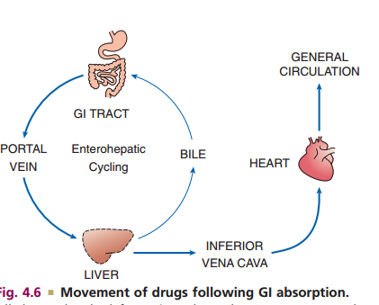

Slide 39
Subcutaneous and intramuscular
drug is deposited directly in the vicinity of the capillaries.
Capillaries being highly porous do not obstruct absorption of even large lipid-insoluble molecules or ions.
Very large molecules are absorbed through lymphatics.
Thus, many drugs not absorbed orally are absorbed parenterally.

Slide 40
Absorption from s.c. site is slower than that from i.m. site, but both are generally faster and more consistent/predictable than oral absorption.
Application of heat and muscular exercise accelerate drug absorption by increasing blood flow,
while vasoconstrictors, e.g. adrenaline injected with the drug (local anaesthetic) retard absorption.
  Many depot preparations,
    e.g. benzathine penicillin,
    protamine zinc insulin,
    depot progestins, etc. can be given by these routes

Slide 41
Topical sites (skin, cornea, mucous membranes)
Systemic absorption after topical application depends primarily on lipid solubility of drugs
Absorption can be promoted by rubbing the drug incorporated in an olegenous base or by use of occlusive dressing which increases hydration of the skin.
Organophosphate insecticides coming in contact with skin can produce systemic toxicity.
Cornea is permeable to lipid soluble, unionized physostigmine but not to highly ionized neostigmine.
Similarly, mucous membranes of mouth, rectum, vagina absorb lipophilic drugs.

Slide 42
BIOAVAILABILITY
refers to the rate and extent of absorption of a drug from a dosage form as determined by its concentration-time curve in blood or by its excretion in urine.
measure of the fraction (F ) of administered dose
of a drug that reaches the systemic circulation in
the unchanged form.
Bioavailability of drug injected i.v. is 100%, but is frequently lower after oral ingestion.
Why? What about S.C and I.M?
Notes:
Bioavailability of drug injected i.v. is 100%, but is frequently lower after oral ingestion because—
(a) the drug may be incompletely absorbed.
(b) the absorbed drug may undergo first pass
metabolism in intestinal wall/liver or be excreted
in bile
Incomplete bioavailability after s.c. or i.m. injection
is less common, but may occur due to local
binding of the drug.

Slide 43
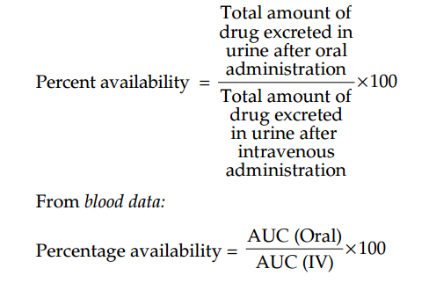

Slide 44
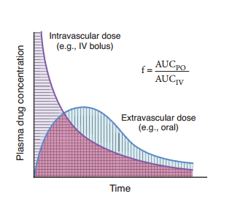
Area Under the Curve for an IV Bolus and Extravascular Doses

Slide 45
the area under the blood concentration-time curve (AUC) is proportional to the dose and the extent of bioavailability for a drug if its elimination is first-order

Slide 46
  What are biologically inequivalent drugs?
  What are bioequivalent drugs?
  Bioavailability variation assumes practical
  significance for drugs with low safety margin (digoxin) or where dosage needs precise control
    oral hypoglycaemics, oral anticoagulants
  It may also be responsible for success or failure of an antimicrobial regimen.
  What are the causes of variation of BAs?
Notes:
Tablets and capsules contain a number of other materials—diluents, stabilizing agents, binders, lubricants, etc. The nature of these as well as details of the manufacture process, e.g. force used in compressing the tablet, may affect disintegration. The released drug must then dissolve in the aqueous gastrointestinal contents. The rate of dissolution is governed by the inherent solubility, particle size, crystal form and other physical properties of the drug. Differences in bioavailability may arise due to variations in disintegration and dissolution rates.

Slide 47
Factors Aﬀecting Bioavailability
    First-pass metabolism
    Hepatic diseases
    Enterohepatic cycling

Slide 48
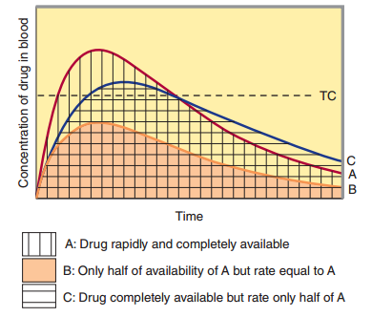
Blood concentration-time curves illustrating how changes in the rate of absorption and extent of bioavailability can influence both the duration of action and the effectiveness of the same total dose of a drug administered in three different formulations.
Notes:
=Too lipophilic and too hydrophilic drugs con not absorbed completely.
=Pumping out of drugs

Slide 49
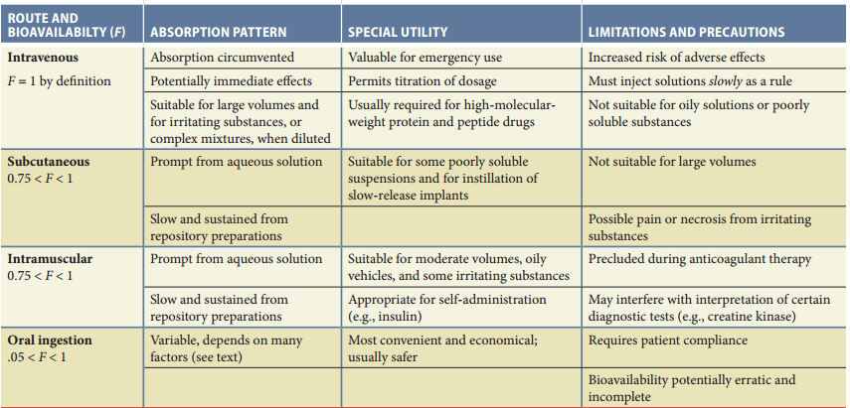

Slide 50
DISTRIBUTION
defined as drug movement from the blood to the interstitial space of tissues and from there into cells.
determined by three major factors:
  blood ﬂow to tissues,
  the ability of a drug to exit the vascular system, and,
  the ability of a drug to enter cells.
    Typical Capillary Beds
    BBB
    Placental transfer
    Protein binding(PPB, SHBPs, TBPs)
In other words, the extent of distribution of a drug depends on
  its lipid solubility,
  ionization at physiological pH (dependent on pKa),
  extent of binding to plasma and
  Tissue proteins and differences in regional blood flow
Notes:
once a drug has gained access to the bloodstream, it gets distributed to other tissues that initially had no drug, concentration gradient being in the direction of plasma to tissues.

Slide 51
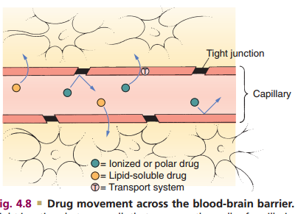
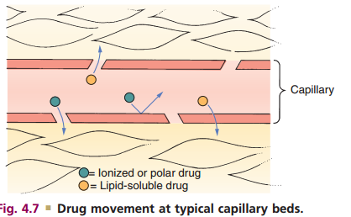
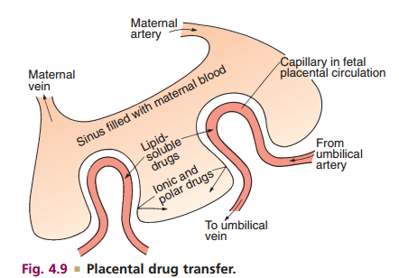
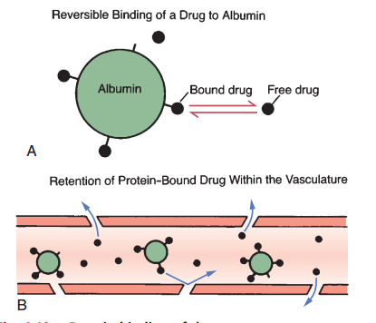

Slide 52
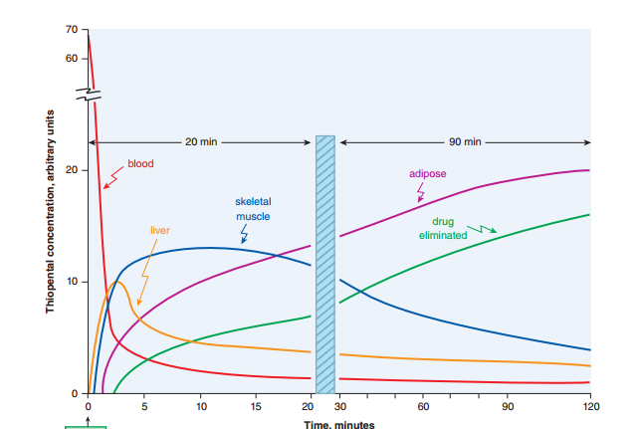
Redistribution: distribution of the barbiturate anesthetic thiopental into different body compartments following a single rapid intravenous dose

Slide 53

Volume of Distribution
Drugs are not distributed equally throughout the body.
    lipophilic substances tend to penetrate all tissue compartments
    hydrophilic compounds are often disseminated more restrictively.
a useful indicator of how drugs are dispersed among the various body compartments.
Notes:
Pathological states, e.g. congestive heart failure, uraemia, cirrhosis of liver, etc. can alter the V of many drugs by altering distribution of body water, permeability of membranes, binding proteins or by accumulation of metabolites that displace the drug from binding sites.

Slide 54
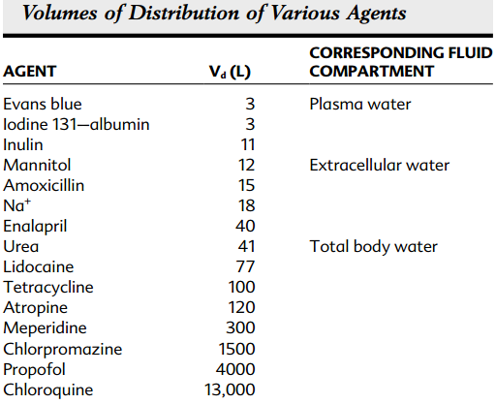

Slide 55
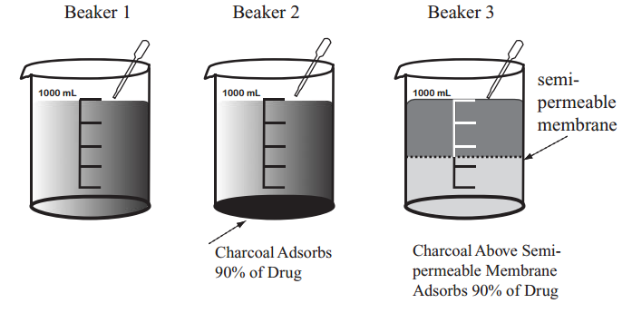
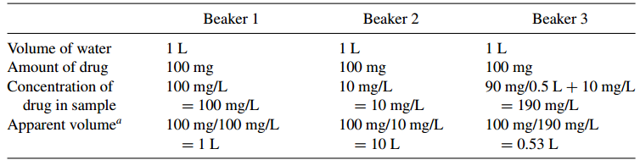

Slide 56
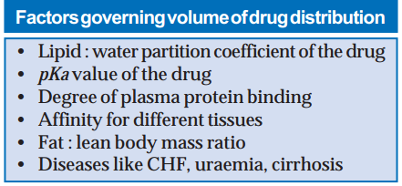
Notes:
(vi)In hypoalbuminaemia, binding may be reduced and high concentrations of free drug may be
attained, e.g. phenytoin and furosemide. Other
diseases may also alter drug binding, e.g.
phenytoin and pethidine binding is reduced in
uraemia; propranolol binding is increased in
pregnant women and in patients with
inflammatory disease (acute phase reactant α1
acid-glycoprotein increases)

Slide 57
Tissue storage
Drugs may also accumulate in specific organs or get bound to specific tissue constituents,
  e.g.—Drugs sequestrated in various tissues are differentially distributed, tend to have large volume of distribution and long duration of action.
Some may exert local toxicity due to high concentration,
  e.g. tetracyclines on bone and teeth, chloroquine
  on retina, emetine on heart and skeletal muscle.
Drugs may also selectively bind to specific intracellular organelle,
  e.g. tetracycline to mitochondria, chloroquine to nuclei.

Slide 58
  Discuss how PH affects drug absorption and distribution and what ion trapping is?
  Both heparin and ethanol are water soluble. Unfortunately, they have different volume of distribution. Discuss it.
  What is bioavailability and mention the factors that affect it.

Slide 59
BIOTRANSFORMATION
(Metabolism)
Biotransformation means chemical alteration of the drug in the body.
WHY?
needed to render nonpolar (lipid soluble) compounds polar (lipid insoluble) so that they are not reabsorbed in the renal tubules and are excreted.
Most hydrophilic drugs,
  e.g. gentamicin, neostigmine, decamethonium, etc. are not biotransformed and are excreted unchanged.

Slide 60
Biotransformation of drugs may lead to the
following.
    Inactivation (Most drugs and their active
    metabolites are rendered inactive or less active)
    Active metabolite from an active drug
    Activation of inactive drug(prodrug)

Slide 61
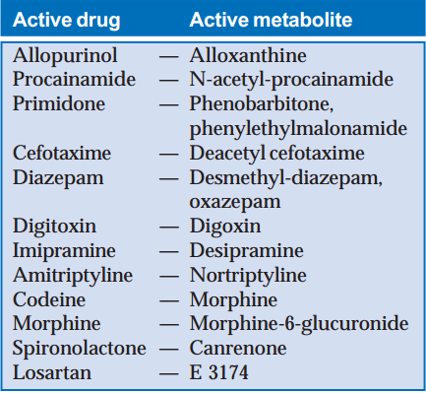
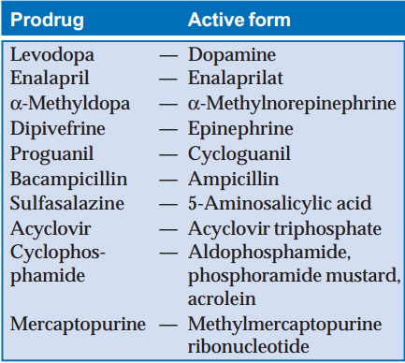

Slide 62
Biotransformation reactions can be classified into:
Nonsynthetic reactions :Phase I reactions: a functional group may be generated/exposed—metabolite may be active or inactive.
  Oxidation (the most important drug metabolizing reactions)
    Barbiturates, phenothiazines, paracetamol, steroids, phenytoin, benzodiazepines, theophylline and many other drugs are oxidized in this way.
  Reduction (Drugs primarily reduced are chloramphenicol, halothane and warfarin)
  Hydrolysis (amides and polypeptides are hydrolyzed by amidases and peptidases.)
    Examples are choline esters, procaine, lidocaine, procainamide, pethidine, oxytocin.

Slide 63
Synthetic reactions
  (Phase II reactions)—metabolite is mostly inactive except few drugs, e.g. morphine-6-glucuronide.
  involve conjugation of the drug or its phase I metabolite with an endogenous substrate, generally derived from carbohydrate or amino acid, to form a polar highly ionized organic acid, which is easily excreted in urine or bile.
  Glucuronide conjugation
    the most important synthetic reaction carried out by a group of UDP-glucuronosyl transferases (UGTs).
    chloramphenicol, aspirin, morphine, metronidazole. bilirubin, steroidal hormones and thyroxine utilize this pathway.
    Drug glucuronides excreted in bile can be hydrolyzed by bacteria in the gu the liberated drug is reabsorbed and undergoes the same fate.
    This enterohepatic cycling of the drug prolongs its action, e.g. phenolphthalein,
    oral contraceptives.

Slide 64
Acetylation
  Compounds having amino or hydrazine residues are conjugated with the help of acetyl coenzyme-A, e.g. sulfonamides, isoniazid, PAS, hydralazine.
  Multiple genes control the N-acetyl transferases (NATs) and rate of acetylation shows genetic polymorphism (slow and fast acetylators)
Methylation
Sulfate conjugation
  The phenolic compounds and steroids are sulfated by sulfotransferases (SULTs), e.g. chloramphenicol, adrenal and sex steroids.
  )
Glycine conjugation

Slide 65
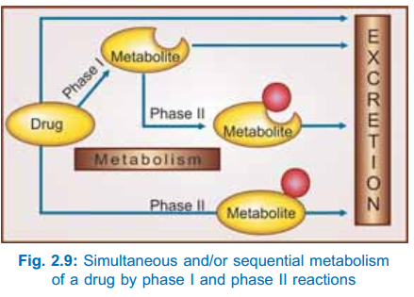
Glutathione conjugation
e.g. paracetamol

Slide 66
Drug metabolizing enzymes
Microsomal enzymes
  Located on smooth endoplasmic reticulum.
    E.g. monooxygenases
    Cytochrozome p450
    UGTs
  Catalyze most of the
      Reductions
      Oxidations
      Hydrolysis
      Glucuronide conjugations
  Are inducible by drugs, diet and other agents.

Slide 67
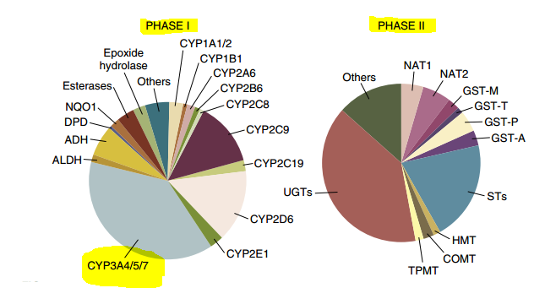

Slide 68
Nonmicrosomal enzymes
  Present in the cytoplasm and mitochondria of the hepatic cells as well as in other tissues including plasma.
    e.g. flavoprotein oxidases
    Esterases
    Amidases
    Conjugates
  Catalyze
      Some oxidation and reductions
      Many hydrolytic reactions
      All conjugations except glucuronidation reaction.
  Are not inducible but many show genetic polymorphism(acetyl transferases, pseudocholisterases)

Slide 69
INHIBITION OF DRUG METABOLISM
One drug can competitively inhibit the metabolism of another if it utilizes the same enzyme or cofactors.
  e.g. quinidine is metabolized by CYP3A4 but inhibits CYP2D6.
Clinically significant inhibition of drug metabolism occurs in case of drugs having affinity for the same isoenzyme, especially if they are metabolized by saturation kinetics or if kinetics changes from first order to zero order over the therapeutic range (capacity limited metabolism).

Slide 70
inhibition of drug metabolism occurs in a dose-related manner and can precipitate toxicity of the object drug (whose metabolism has been inhibited).
Metabolism of drugs with high hepatic extraction is dependent on liver blood flow (blood flow limited metabolism).
Propranolol reduces rate of lidocaine metabolism by decreasing hepatic blood flow.

Slide 71
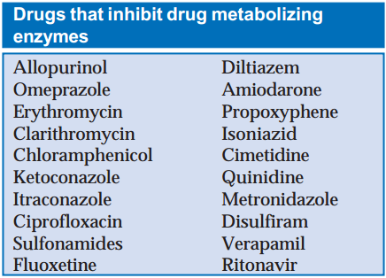

Slide 72
MICROSOMAL ENZYME INDUCTION
Many drugs, insecticides and carcinogens interact with DNA and increase the synthesis of microsomal enzyme protein, especially cytochrome P-450 and glucuronyl transferase.
Different inducers are relatively selective for certain cytochrome P-450 enzyme families, e.g.:
    Anticonvulsants including phenobarbitone, rifampin, glucocorticoids induce CYP3A
    isoenzymes.
    Phenobarbitone also induces CYP2B1 and rifampin also induces CYP2D6.
    Isoniazid and chronic alcohol consumption induce CYP2E1.
    Polycyclic hydrocarbons like 3-methylcholanthrene and benzopyrene found in cigarette smoke, charcoalbroiled meat and industrial pollutants induce CYP1A isoenzymes.
    Other important enzyme inducers are: chloral hydrate, griseofulvin, DDT.

Slide 73
Phenobarbitone like inducers of CYP3A and CYP2D6 affect the metabolism of a large number of drugs, because these isoenzymes act on many drugs.

Slide 74
Consequences of microsomal enzyme induction
Decreased intensity and/or duration of action of drugs that are inactivated by metabolism,
  e.g. OC failure
Increased intensity of action of drugs that are activated by metabolism.
  E.g. acute Paracetamol toxicity
Tolerance(in case of autoinduction)
  e.g. carbamazepine, rifampin.
Some endogenous substrates (steroids, bilirubin) are also metabolized faster.

Slide 75
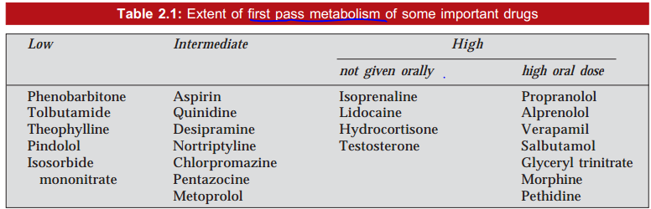
Drugs whose metabolism is significantly affected by enzyme induction are—
      phenytoin, warfarin, tolbutamide, imipramine, oral contraceptives, chloramphenicol, doxycycline, theophylline, griseofulvin.
Notes:
Possible uses of enzyme induction
1. Congenital nonhaemolytic jaundice: phenobarbitone causes rapid clearance of jaundice.
2. Cushing’s syndrome: phenytoin may reduce
the manifestations.
3. Chronic poisonings.
4. Liver disease.

Slide 76
EXCRETION
RENAL EXCRETION
  The kidney is responsible for excreting all water soluble substances.
  The amount of drug or its metabolites ultimately present in urine is the sum total of glomerular filtration, tubular reabsorption and tubular secretion
Glomerular filtration
  all nonprotein bound drug (whether-lipid soluble or insoluble) presented to the glomerulus is filtered.
  depends on its plasma protein binding and renal blood flow.
  normally ~ 120 mL/min, declines progressively after the age of 50 and is low in renal failure.

Slide 77
Tubular reabsorption
  depends on lipid solubility and ionization of the drug at the existing urinary pH.
  Lipid-soluble drugs filtered at the
  glomerulus back diffuse passively in the tubules because 99% of glomerular filtrate is reabsorbed.
  Thus, rate of excretion of such
  drugs, e.g. aminoglycoside antibiotics, quaternary
  ammonium compounds parallels g.f.r. (or
  creatinine clearance).
  urine is alkalinized in barbiturate and salicylate poisoning

Slide 78
Tubular secretion
  active transfer of organic acids and bases by two separate classes of nonspecific transporters (OATP and OCT) which operate in the proximal tubules.
  In addition efflux transporters P-gp and MRP2 are
  located in luminal membrane of proximal tubular
  cells.
  reduces the concentration of its free form in the
  tubular vessels and promotes dissociation of
  protein bound drug, which again is secreted
  Thus, protein binding is not hinderance (may even be facilitatory) to excretion by tubular secretion.

Slide 79
Organic acid transport (by OATP) for
  penicillin, probenecid, uric acid, salicylates, sulfinpyrazone, nitrofurantoin, methotrexate,
  drug glucuronides, etc.
Organic base transport (through OCT) for
thiazides, quinine, procainamide, choline, cimetidine, amiloride, etc.
Drugs utilizing the same active transport compete with each other.
Probenecid versus penicillin and uric acid ????

Slide 80
Many drug interactions occur due to competition for
tubular secretion, e.g.
  Salicylates block uricosuric action of probenecid and sulfinpyrazone and decrease tubular secretion of methotrexate.
  Probenecid decreases the concentration of
  nitrofurantoin in urine, increases the duration of
  action of penicillin/ampicillin and impairs secretion of methotrexate.
  Quinidine decreases renal and biliary clearance of digoxin by inhibiting efflux carrier P-gp.

Slide 81
Tubular transport mechanisms are not well
developed at birth.
As a result, duration of action of many drugs, e.g. penicillin, cephalosporins, aspirin is longer in neonates.

Slide 82
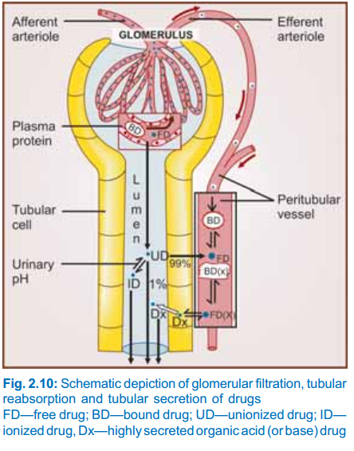

Slide 83

Pharmacokinetic Parameters
Clearance (CL)
theoretical volume of plasma from which the drug is completely removed in unit time (analogy creatinine clearance)
  where C is the plasma concentration
For majority of drugs the processes involved in elimination are not saturated over the clinically obtained concentrations, they follow:

Slide 84
Kinetics of Absorption and Elimination
Zero order (linear) kinetics
  The rate of elimination remains constant irrespective of drug
  concentration,
  CL decreases with increase in concentration(saturation); or a constant amount of the drug is eliminated in unit time, e.g. ethyl alcohol.
  The elimination of some drugs approaches saturation over the therapeutic range, kinetics changes from first order to zero order at higher doses.
  As a result, plasma concentration increases disproportionately with increase in dose as occurs in the case of phenytoin, tolbutamide, theophylline, warfarin
      where dC/dt is the rate of change in concentration, and k0 is a constant in units of amount per time.

Slide 85
continuous intravenous infusion (e.g., 5mg/min).
the body can only eliminate a certain amount of drug no matter what the quantity of drug is in the body
Ethyl alcohol, even in moderately intoxicating doses, is metabolized at a constant rate of approximately 6g/hr for an adult
  alcohol dehydrogenation assume a first-order rate when the concentration comes to far less producing observable effects.
Toxic doses of aspirin is another example. ???

Slide 86
First order (exponential) kinetics
  The rate of elimination is directly proportional to drug concentration, CL remains constant; or a constant fraction of the drug present in the body is eliminated in unit time.
  where
    k1 is the fractional first-order rate constant in units of time,
    dC/dt equals the change in drug concentration with respect to time, and
    Cp is the plasma drug concentration.

Slide 87

Because the fraction of drug affected per unit of time is independent of concentration, as drug load increases, the amount
of drug eliminated per unit time increases.
Thus the half-time (t½) of elimination is useful in determining the rate of drug disappearance
and the concentration of drug remaining after a given period of time

Slide 88
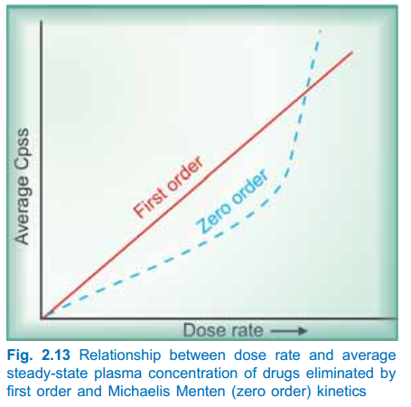

Slide 89
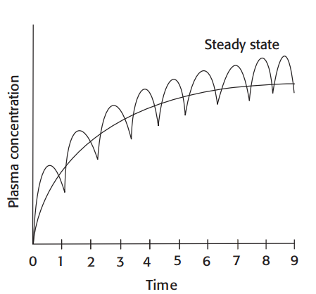
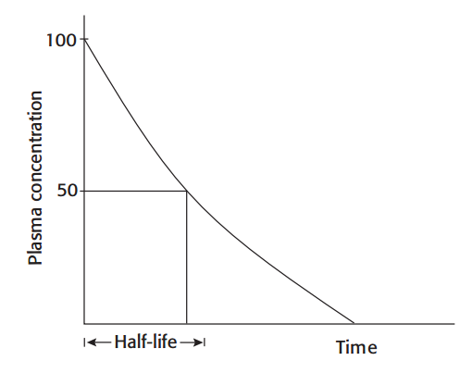
Plasma half-life
It is the time required for the plasma concentration of the drug to decrease by 50% of its original value.
What is the clinical importance of plasma half life?

Slide 90



Half-life is a derived parameter from two variables V and CL both of which may change independently.
It, therefore, is not an exact index of drug elimination.
First order kinetics—t½ remains constant because V and CL do not change with dose.
Zero order kinetics—t½ increases with dose because CL progressively decreases as dose is increased.

Slide 91


Steady State Concentration
What is steady state concentration?
What is loading dose, maintenance dose and why is it?
Used for maintenance dose calculation and is governed by CL (or t½) of the drug.
.

Slide 92
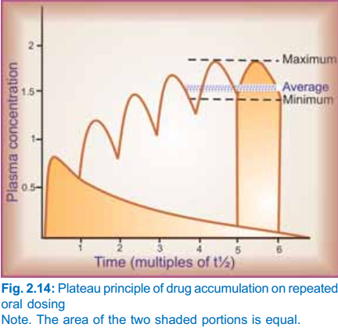

Slide 93

Thus, loading dose is governed only by V and not by CL or t½.

Slide 94
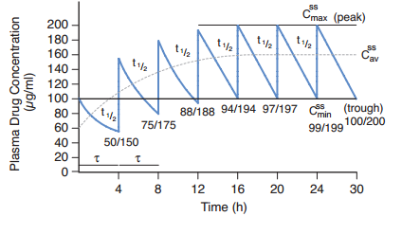

Slide 95
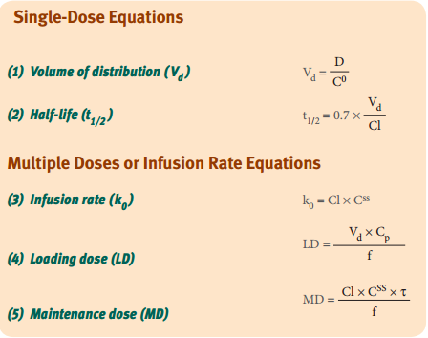
IMPORTANT PHARMACOKINETICS CALCULATIONS

Slide 96
Pharmacodynamics
(Mode of Action of Drugs)
Pharmacodynamics is the study of drug effects
    biochemical
    Physiological
    mechanism of action.
  It is important to describe the effects of a drug quantitatively in order to determine appropriate dose ranges or patients, as well as to compare the potency, efficacy, and safety of one drug to that of another .
  based on the concept of drug–receptor binding.
  When either a drug or an endogenous ligand (such as a hormone or neurotransmitter) binds to its receptor, a response may result from that binding interaction.

Slide 97
PRINCIPLES OF DRUG ACTION
Drugs (except those gene based) do not impart new functions to any system, organ or cell;
they only alter the pace of ongoing activity.
The basic types of drug action can be broadly classed as:
    Stimulation: adrenaline(heart), pilocarpine (salivary glands)
    Depression: barbiturates (CNS), quinidine(heart), Ach(stimulates intestinal smooth muscle, depresses SA node)
    Irritation
    Replacement (levodopa, insulin and iron)
    Cytotoxic action (penicillin, chloroquine, zidovudine, cyclophosphamide etc)

Slide 98
DRUG-RECEPTOR INTERACTIONS
Receptors are the special chemical sites in the body that most drugs interact with to produce effects.
We can define a receptor as any functional macromolecule in a cell to which a drug binds to produce its effects.
many cellular components could be considered drug receptors, because drugs bind to many cellular components (e.g., enzymes, ribosomes, tubulin) to produce their effects.
Or the body’s own receptors for hormones, neurotransmitters, and
other regulatory molecules.

Slide 99
Under physiologic conditions, receptor activity is regulated by endogenous compounds (neurotransmitters, hormones, other regulatory molecules).
The binding of drugs to these receptors can have one of two effects:
  drugs can mimic the action of endogenous NE (and thereby increase cardiac output), or
  drugs can block the action of endogenous NE (and thereby prevent stimulation of the heart by autonomic neurons).

Slide 100
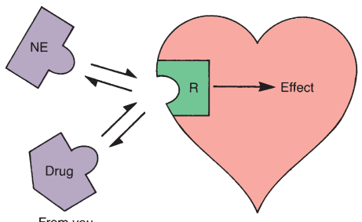
Receptor states??? Agonist versus antagonists???

Slide 101
SIGNALING MECHANISMS
Binding of an agonist drug to its receptor activates an effector or signaling mechanism.
Several different types of drug-responsive signaling mechanisms are known.

Slide 102
  Why do some drugs produce effects that persist for minutes, hours, or even days after the drug is no longer present?
  Why do responses to other drugs diminish rapidly with prolonged or repeated administration?
  How do cellular mechanisms for amplifying external chemical
  signals explain the phenomenon of spare receptors?
  Why do chemically similar drugs often exhibit extraordinary selectivity in their actions?
  Do these mechanisms provide targets for developing new drugs?

Slide 103
Intracellular Receptors
include receptors for steroids.
Binding of hormones or drugs to such receptors releases regulatory proteins that permit activation and in some cases dimerization of the hormone-receptor complex.
Such complexes translocate to the nucleus, where they interact with response elements in spacer DNA.
leads to changes in gene expression.

Slide 104
For example, drugs interacting with glucocorticoid receptors lead to gene expression of proteins that inhibit the production of inflammatory mediators.
Others include receptors for thyroid hormones, gonadal steroids, and vitamin D.
Pharmacologic responses elicited via modification of gene expression are usually slower in onset but longer in duration than many other drugs.

Slide 105
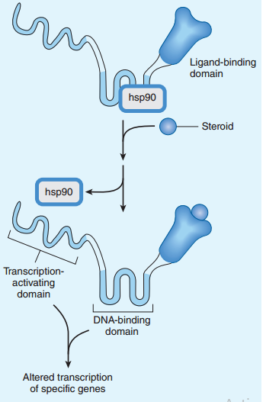
Mechanism of glucocorticoid action

Slide 106
Membrane Receptors Directly Coupled to Ion Channels
  Many drugs act by mimicking or antagonizing the actions of endogenous ligands that regulate flow of ions through excitable membranes via their activation of receptors that are directly coupled (no second messengers) to ion channels.
  For example, the nicotinic receptor for ACh (present in autonomic nervous system [ANS] ganglia, the skeletal myoneural junction, and the central nervous system [CNS]) is coupled to a Na+/K+ ion channel.
    The receptor is a target for many drugs, including nicotine, choline esters, ganglion blockers, and skeletal muscle relaxants.

Slide 107
  Similarly, the GABAA receptor in the CNS, which is coupled to a chloride ion channel, can be modulated by anticonvulsants, benzodiazepines, and barbiturates.

Slide 108
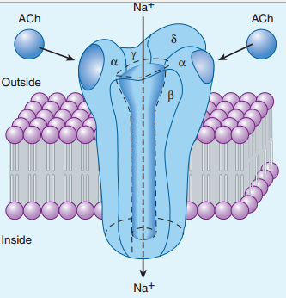
The nicotinic acetylcholine (ACh) receptor, a ligand-gated ion channel

Slide 109
Receptors Linked Via Coupling Proteins to Intracellular Effectors(G proteins and second messengers)
  Many receptor systems are coupled via GTP-binding proteins
  (G-proteins) to adenylyl cyclase, the enzyme that converts ATP to cAMP, a second messenger that promotes protein phosphorylation by activating protein kinase A.
  These receptors are typically “serpentine,” with seven transmembrane spanning domains, the third of which is coupled to the G-protein effector mechanism.
  Protein kinase A serves to phosphorylate a set of tissue-specific substrate enzymes or transcription factors (CREB), thereby affecting their activity.

Slide 110
G_{s} proteins
  Binding of agonists to receptors linked to Gs proteins increases cAMP production.
    include (beta), dopamine (D1), glucagon, histamine (H2), prostacyclin, and some serotonin subtypes receptors.
G_{i} proteins
  Binding of agonists to receptors linked to Gi proteins decreases cAMP production.
    include adrenoreceptors (alpha2), ACh (M2), dopamine (D2 subtypes), and several opioid and serotonin subtypes.

Slide 111
G_{q} proteins
  Other receptor systems are coupled via GTP-binding proteins (G_{q}), which activate phospholipase C.
  Activation of this enzyme releases the second messengers inositol triphosphate (IP3) and diacylglycerol (DAG) from the membrane phospholipid phosphatidylinositol bisphosphate (PIP2).
  The IP3 induces release of Ca2+ from the sarcoplasmic reticulum
  (SR), which, together with DAG, activates protein kinase C.

Slide 112
  The protein kinase C serves then to phosphorylate a set of tissue-specific substrate enzymes, usually not phosphorylated by protein kinase A, and thereby affects their activity.
  These signaling mechanisms are invoked following activation of receptors for ACh (M1 and M3), norepinephrine (alpha1), angiotensin II, and several serotonin subtypes.

Slide 113
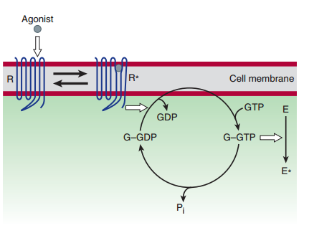
The guanine nucleotide-dependent activationinactivation cycle of G proteins

Slide 114
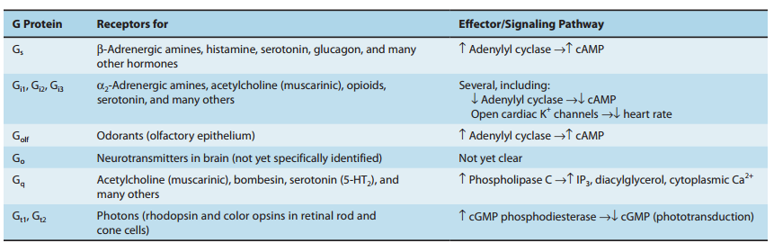
G proteins and their receptors and effectors

Slide 115
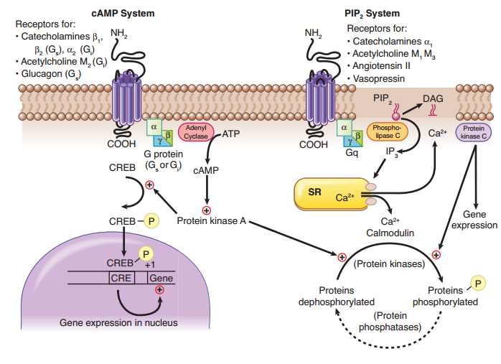
Receptors Using Cyclic AMP and IP3, DAG, Ca2+ as Second Messengers

Slide 116
Cyclic GMP and Nitric Oxide Signaling
  cGMP is a second messenger in vascular smooth muscle that facilitates dephosphorylation of myosin light chains, preventing their interaction
  with actin and thus causing vasodilation.
  Nitric oxide (NO) is synthesized in endothelial cells and diffuses into smooth muscle.
  NO activates guanylyl cyclase, thus increasing cGMP in smooth muscle.
  Vasodilators ↑ synthesis of NO by endothelial cells

Slide 117
Receptors That Function as Enzymes or Transporters
  There are multiple examples of drug action that depend on enzyme inhibition, including inhibitors of acetylcholinesterase, angiotensinconverting enzyme, aspartate protease, carbonic anhydrase, cyclooxygenases, dihydrofolate reductase, DNA/RNA polymerases, monoamine oxidases, Na/K-ATPase, neuraminidase, and reverse transcriptase.
  Examples of drug action on transporter systems include the inhibitors of reuptake of several neurotransmitters, including dopamine, GABA, norepinephrine, and serotonin.

Slide 118
Receptors That Function as Transmembrane Enzymes
  mediate the first steps in signaling by insulin and growth factors, including epidermal growth factor (EGF) and platelet-derived growth factor (PDGF).
  are membrane-spanning macromolecules with recognition sites for the binding of insulin and growth factors located externally and a cytoplasmic domain that usually functions as a tyrosine kinase.

Slide 119
  Binding of the ligand causes conformational changes (e.g., dimerization) so that the tyrosine kinase domains become activated, ultimately leading to phosphorylation of tissue-specific substrate proteins.
  Guanyl cyclase-associated receptors: stimulation of receptors to atrial natriuretic peptide activates the guanyl cyclase and ↑ cyclic GMP (cGMP)

Slide 120
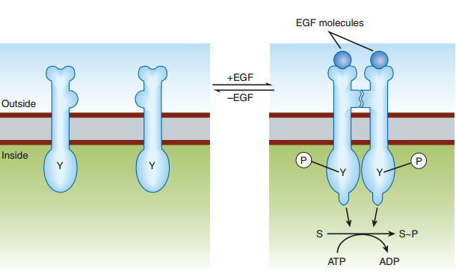
Mechanism of activation of the epidermal growth factor (EGF) receptor, a representative receptor tyrosine kinase
Some receptor tyrosine kinases form oligomeric complexes larger than dimers upon activation by ligand, but the pharmacologic significance of such higher-order
complexes is presently unclear.)

Slide 121
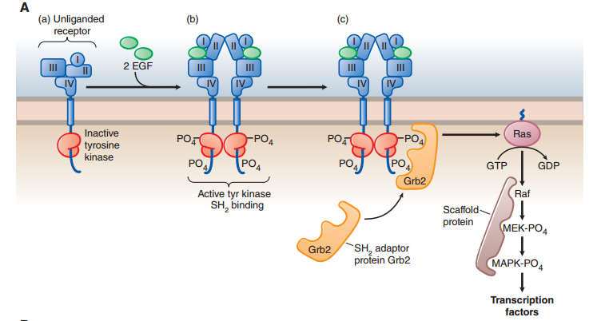
Mechanism of activation of a receptor tyrosine kinase

Slide 122
  Inhibitors of particular receptor tyrosine kinases are finding increased use in neoplastic disorders in which excessive growth factor signaling is often involved.
  Some of these inhibitors are monoclonal antibodies (eg, trastuzumab, cetuximab), which bind to the extracellular domain of a particular receptor and interfere with binding of growth factor.
  Other inhibitors are membranepermeant small molecule chemicals (eg, gefitinib, erlotinib), which inhibit the receptor’s kinase activity in the cytoplasm.

Slide 123
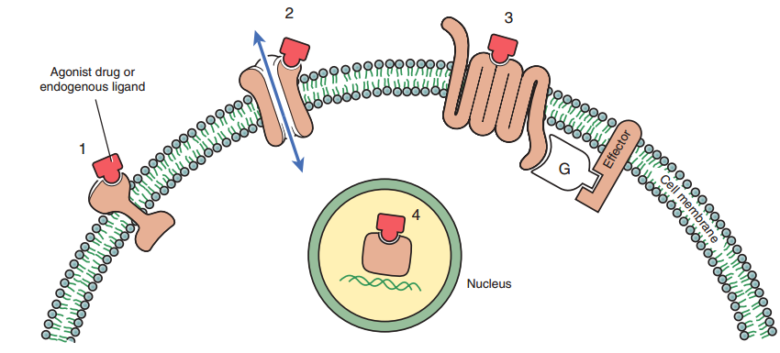
2. Ligand-gated ion channel
3. G protein–coupled receptor system (G, G protein)
1. Cell membrane–embedded enzyme (e.g. Insulin)
4. Transcription factor
e.g. steroid hormones (VitD, glucocorticoids, sex hormones, mineralocorticoid hormones ) and Thyroide hormones
=(lipid soluble ligands)
The four primary receptor families

Slide 124
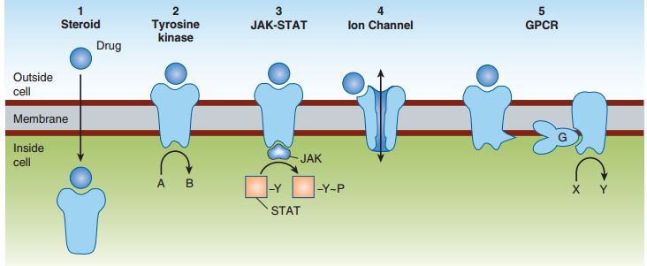
Signaling mechanisms for drug effects

Slide 125
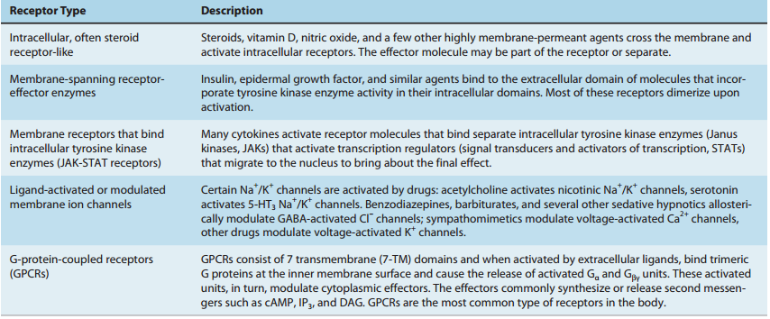

Slide 126
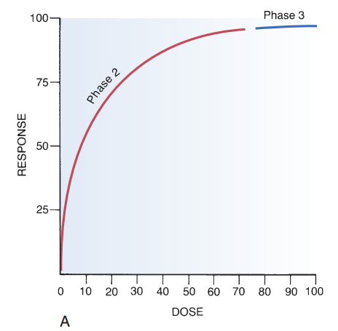
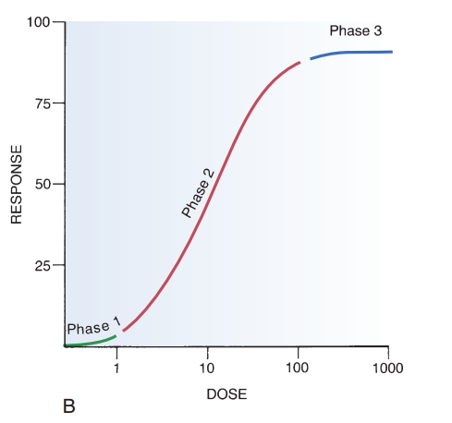
DOSE–RESPONSE RELATIONSHIPS
Part B shows the same data plotted on
semilogarithmic coordinates (i.e., the scale on which dosage is plotted is logarithmic rather than linear).
Part A shows dose-response data plotted
on linear coordinates.
Notes:
A, A dose-response curve with dose plotted on a linear scale. B, The same dose-response
relationship shown in A but with the dose plotted on a logarithmic scale. Note the three
phases of the dose-response curve: Phase 1, The curve is relatively ﬂat; doses are too low
to elicit a signifcant response. Phase 2, The curve climbs upward as bigger doses elicit
correspondingly bigger responses. Phase 3, The curve levels off; bigger doses are unable to
elicit a further increase in response. (Phase 1 is not indicated in A because very low doses
cannot be shown on a linear scale.)

Slide 127
dose-response relationship is graded.
therapeutic effects can be adjusted to fit the needs of each patient by raising or lowering the dosage until a response of the desired intensity is achieved.
the dose-response relationship can be viewed as having three phases.

Slide 128
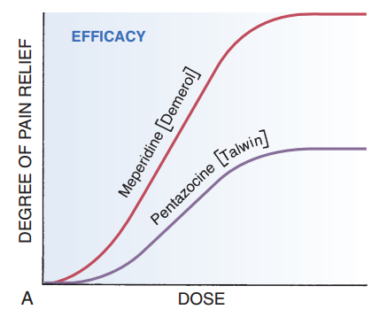
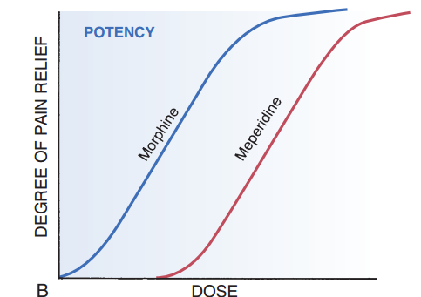
Dose-response curves reveal two characteristic properties of drugs:
  maximal efficacy and relative potency
Dose-response curves demonstrating efficacy and potency

Slide 129
Receptors and Selectivity of
Drug Action
selectivity, the ability to elicit only
the response for which a drug is given, is a highly desirable characteristic of a drug because the more selective a drug is, the fewer side effects it will produce.
Selective drug action is possible, in large part, because drugs act through specifc receptors.

Slide 130
The body employs many different kinds of receptors to
regulate its sundry physiologic activities.
There are receptors for
  each neurotransmitter (e.g., NE, acetylcholine, dopamine);
  each hormone (e.g., progesterone, insulin, thyrotropin); and
  all of the other molecules the body uses to regulate physiologic processes (e.g., histamine, prostaglandins, leukotrienes).
Selective drug action is made possible by the existence of many types of receptors, each regulating just a few processes.
Drug with only one type of receptor versus many receptors????

Slide 131
  The binding of acetylcholine (a neurotransmitter) to its receptor illustrates the lock-and-key analogy
  To bind with its receptor, acetylcholine must have a shape that is complementary to the shape of the receptor.
  acetylcholine must possess positive charges that are positioned so as to permit their interaction with corresponding negative sites on the receptor.
  Like the acetylcholine receptor, all other receptors impose specific requirements on the molecules with which they will interact.

Slide 132
  Because receptors have such specific requirements, it is possible to synthesize drugs that interact with just one receptor type preferentially over others.
  Such medications tend to elicit selective responses.
  Can selective drugs produce nonselective effects?
  Does selectivity indicates safety?

Slide 133
Theories of Drug-Receptor Interaction
two theories of drug-receptor interaction:
(1) the simple occupancy theory
States that
  the intensity of the response to a drug is proportional to the number of receptors occupied by that drug and
  a maximal response will occur when all available receptors have been occupied.
In other words, it assumes that all drugs acting at a particular receptor are identical
with respect to
  the ability to bind to the receptor and
  the ability to inﬂuence receptor function once binding has taken place.

Slide 134

Model of simple occupancy theory

Slide 135
(2) the modified occupancy theory.
  ascribes two qualities to drugs: affinity and intrinsic activity.
Affinity
  refers to the strength of the attraction between a drug and its receptor
  Drugs with high affinity are strongly attracted to their receptors.
  is reﬂected in its potency.
  drugs with high affinity can bind to their receptors when present in low concentrations.
  That is, drugs with high affinity are very potent.

Slide 136
Intrinsic Activity
  refers to the ability of a drug to activate a receptor upon binding.
  Drugs with high intrinsic activity cause intense receptor activation.
  is reﬂected in its maximal efficacy.
  Drugs with high intrinsic activity have high maximal efficacy.
  That is, by causing intense receptor activation, they are able to cause intense responses.

Slide 137
the intensity of the response to a drug is still related to the number of receptors occupied.
two drugs can occupy the same number of receptors but produce effects of different intensity; the drug with greater intrinsic activity will produce the more intense response.

Slide 138
Agonists, Antagonists, and
Partial Agonists
Agonists
  Drugs that elicit a response from a tissue are known as agonists.
  Agonists that produce ceiling effects—effects that are
  not exceeded by other drugs—are called full agonists, and drugs whose maximal effects are less than those of full agonists are referred to as partial agonists.
  unrelated to variances in receptor affinity
  rather, it is due to differences in their abilities to activate signal
  transduction changes after binding.

Slide 139

Concentration-response curves for three agonists acting at the same receptor

Slide 140
Indirect agonists
  are those that increase the level of direct agonists often by reducing the rate of metabolism of the direct agonist.
  use of cholinesterase inhibitors to increase endogenous levels of acetylcholine, thereby increasing the effect of acetylcholine at its
  receptors.

Slide 141
Inverse agonist
has full affinity towards the receptor
but produces effect opposite to that of an
agonist.
benzodiazepines versus carbolines at benzodiazepine receptors
intrinsic activity between 0 and -1 (e.g. carbolines)

Slide 142
Antagonists
  Drugs that inhibit the effects of agonists are called antagonists.
  Pure antagonists have an intrinsic activity of zero
  competitive antagonists
    Antagonists that bind reversibly to a receptor at the same site as the agonist
    depresses the response to a given dose or concentration of agonist making receptors less available for agonist binding.
    a parallel shift to the right of the agonist concentration-response curve
    is completely surmountable by a sufficiently high concentration of agonist.
    produces an apparent reduction in the affinity of an agonist for its receptor.

Slide 143

Antihistamines versus histamine, naloxone versus morphine, propranolol versus epinephrine

Slide 144
Noncompetitive
  bind irreversibly to receptors
  equivalent to reducing the total number of receptors available for activation by an agonist.
  reduce the maximal response that an agonist can elicit.
  If sufficient antagonist is present, agonist effects will be blocked completely
  inhibition by these agents cannot be overcome, no matter how much agonist may be available.

Slide 145


Slide 146
Combined Eﬀects of Drugs
A combination of two or more drugs can result in an increase or a decrease in response.
Increased response
  Additive effect :ibuprofen and paracetamol as analgesic
  Potentiation (supra-additive)
    levodopa + carbidopa
    acetylcholine + physostigmine
  Synergism:
    sulphamethoxazole + trimethoprim

Slide 147
Decreased response (drug antagonism)
the effect of one drug is decreased or abolished in the presence of another drug
Physical antagonism:
  due to their physical property
  activated charcoal adsorbs toxic substances in poisoning.
Chemical antagonism:
  due to their chemical property
  antacids are weak bases that neutralize gastric acid
  chelating agents complex metals and are useful in heavy metal poisoning.

Slide 148
Physiological (functional) antagonism:
  two drugs act
  at different receptors or
  by different mechanisms on the same physiological system and produce opposite effects.
    insulin and glucagon
    adrenaline and histamine on bronchial smooth muscle
Receptor antagonism:
  Competitive and noncompetitive

Slide 149

THE THERAPEUTIC INDEX
a measure of a drug’s safety.
determined using laboratory animals,
defined as the ratio of a drug’s LD50 to its ED50.

Slide 150

Distance between ED50 and LD50 indicates safety margin.

Slide 151
Receptor regulation and drug tolerance
Receptors exist in a dynamic state; their density and efficacy is subject to regulation by the level of ongoing activity and other physiopathological influences.
In tonically active systems, prolonged deprivation of the agonist (by denervation or continued use of an antagonist or a drug which reduces input) results in supersensitivity of the receptor as well as the effector system to the agonist.

Slide 152
This has clinical relevance in clonidine and CNS depressant/opioid withdrawal syndromes, sudden discontinuation of propranolol in angina pectoris, etc.
The mechanisms involved may be unmasking of receptors or their proliferation (up regulation) or accentuation of signal amplification by the transducer
Conversely, continued intense receptor stimulation causes desensitization or refractoriness: the receptor becomes less sensitive to the agonist.

Slide 153
bronchial asthma patients treated continuously with β-adrenergic agonists and parkinsonian patients treated with high doses of levodopa.
The changes may be brought about by:
  Masking or internalization of the receptor
  (the receptor becomes inaccessible to the agonist).
    refractoriness develops as well as fades quickly
  Decreased synthesis/increased destruction of the receptor (down regulation):
    refractoriness develops over weeks or months and recedes slowly.
  Receptor downregulation is particularly exhibited by the tyrosine protein kinase receptors.

Slide 154
Sometimes response to all agonists which act through different receptors but produce the same overt effect (e.g. histamine and acetylcholine both contract intestinal smooth muscle) is decreased by exposure to any one of these agonists (heterologous desensitization), showing that mechanisms of response effectuation have become less efficient.
However, often desensitization is limited to agonists of the receptor being repeatedly activated (homologous desensitization).

Slide 155
Drug Tolerance
refers to the requirement of higher dose of a drug to produce a given response.
is a widely occurring adaptive biological phenomenon.
Drug tolerance may be:
  Natural
    The species/individual is inherently less sensitive to the drug,
    e.g. rabbits are tolerant to atropine, black races are tolerant to mydriatics.

Slide 156
Acquired
  occurs by repeated use of a drug in an individual who was initially responsive
  Body is capable of developing tolerance to most drugs, but the phenomenon is very easily recognized in the case of CNS depressants.
  An uninterrupted presence of the drug in the body favours development of tolerance.
  However, significant tolerance does not develop to atropine, digitalis, cocaine, sodium nitroprusside, etc

Slide 157
Tolerance need not develop equally to all actions of a drug; consequently, therapeutic index of a drug may increase or decrease with prolonged use, e.g.:
  develops to sedative action of chlorpromazine but not to its antipsychotic action.
  occurs to the sedative action of phenobarbitone but not to its antiepileptic action.
  occurs to analgesic and euphoric action of morphine but not to its constipating and miotic actions.

Slide 158
Cross tolerance
  development of tolerance to pharmacologically related drugs, e.g.
    alcoholics are relatively tolerant to barbiturates
    and general anaesthetics.
    Closer the two drugs are, more complete is the cross tolerance between them, e.g.
      partial cross tolerance between morphine and barbiturates
      but complete cross tolerance between morphine and pethidine.

Slide 159
Mechanisms of drug tolerance
  are incompletely understood.
  tolerance may be:
Pharmacokinetic/drug dispositional tolerance—
  the effective concentration of the drug at the site of action is decreased, mostly due to enhancement of drug elimination on chronic use,
    e.g. barbiturates, carbamazepine, amphetamine.
Pharmacodynamic/functional/cellular tolerance—
  drug action is lessened; cells of the target organ become less responsive,
    e.g. morphine, barbiturates, nitrates.
  This may be due to downregulation of receptors, weakening of response effectuation or other compensatory homeostatic mechanisms
    e.g. antihypertensives

Slide 160
Tachyphylaxis (Tachy-fast, phylaxis-protection)
  is rapid development of tolerance—doses of a drug repeated in quick succession result in marked reduction in response.
  This is usually seen with indirectly acting drugs, e.g. ephedrine, tyramine, nicotine: they act by releasing catecholamines in the body, synthesis of which is unable to match the rate of release: stores get depleted.
  Other mechanisms like slow dissociation of the drug from its receptor, internalization of receptor, homeostatic adaptation, etc. may also be involved.

Slide 161

Tachyphylaxis. BP: Blood pressure

Slide 162
Drug resistance
  It refers to tolerance of microorganisms to inhibitory action of antimicrobials,
  e.g. Staphylococci to penicillin

Slide 163
Drug dependence
WHO defines drug dependence as ‘a state—psychic and sometimes also physical—resulting from the interaction between a living organism and a drug, characterized by behavioural and other response that always includes a compulsion to take the drug on a continuous or periodic basis in order to experience its psychic effects and sometimes to avoid the discomfort of its absence’,

Slide 164
The dependence could be psychological or physical.
Psychological dependence:
  an intense desire to continue taking the drug as the patients feel/believe that their well-being depends upon the drug.
  Reinforcement is the ability of the drug to produce effects that make the user wish to take it again.
  Certain drugs (opioids, cocaine) are strong reinforcers, while others (benzodiazepines) are weak reinforcers. Faster the drug acts, more reinforcing it is.

Slide 165
Physical dependence:
  Repeated drug use produces physiological changes in the body that makes continuous presence of the drug in the body necessary to maintain normal function.
  Since the essence of the process is adaptation of the nervous system to function normally in the presence of the drug, it has been called ‘neuroadaptation’
  Drugs producing physical dependence are— opioids, barbiturates and other depressants including alcohol and benzodiazepines. Stimulant drugs, e.g. amphetamines, cocaine produce little or no physical dependence.

Slide 166
  Abrupt stoppage of the drug results in an imbalance wherein the body has to readjust to the absence of the drug resulting in the development of signs and symptoms known as withdrawal syndrome.
  The withdrawal signs and symptoms are generally opposite to the effects produced by the drug.

Slide 167
Drug addiction
  It is a pattern of compulsive drug use characterized by overwhelming involvement with the use of a drug.
  Procuring the drug and using it takes precedence over other activities.
  Even after withdrawal most addicts tend to relapse.
  Physical dependence, though a strong impetus for continued drug use, is not an essential feature of addiction.
  Amphetamines, cocaine, cannabis, LSD are drugs which produce
  addiction but little/no physical dependence.
  On the other hand, drugs like nalorphine produce physical dependence without imparting addiction in the sense that there is little drug seeking behavior.

Slide 168
Drug habituation
  It denotes less intensive involvement with the drug, so that its withdrawal produces only mild discomfort.
  Consumption of tea, coffee, tobacco, social drinking are regarded habituating, physical dependence is absent.
  Basically, habituation and addiction imply different degrees of psychological dependence and it may be difficult to draw a clear-cut line of distinction between the two.
  Therefore, it is better to avoid using these terms in describing drug dependence and related conditions.

Slide 169
Drug withdrawal reactions
  sudden interruption of therapy with certain other drugs also results in adverse consequences, mostly in the form of worsening of the clinical condition for which the drug was being used, e.g.:
    Acute adrenal insufficiency may be precipitated by abrupt cessation of corticosteroid therapy.
    Severe hypertension and sympathetic overactivity may occur shortly after discontinuing clonidine.

Slide 170
    Worsening of angina pectoris or myocardial
    infarction may result from stoppage of β
    blockers.
    Frequency of seizures may increase on
    sudden withdrawal of an antiepileptic.
These manifestations are also due to adaptive changes and can be minimized by gradual withdrawal.

